Slide 1
The Measure of Disseminability (MOD)
Lindsay R. Trent, M.A.
University of Mississippi
Erin Buchanan, Ph.D.
Missouri State
John Young, Ph.D.
University of Mississippi
Scientific Infusion That Helps
The SITH lab
Notes:
Insert SITH lab.
Fix Charts
Add other authors

Slide 2
Introduction
Evidence-Based Practice (EBP) rare in practice-oriented environments
Unique challenges in these settings
Effectiveness research
Dissemination method
No formalized way to assess a priori

Slide 3
Current study
Develop a tool capable of assessing dissemination-relevant variables
Psychometric examination
Assess generalizability in an independent sample
Notes:
The goal of the current study was two-fold; first, to create a Measure of Disseminability (MOD) and subject it to scientific examination of its psychometric properties and secondly, to examine the generalizability of the measure’s psychometric properties in an independent sample.

Slide 4
Measure of Disseminability (MOD)
Iterative measure development (e.g., Haynes, Richard, & Kubany, 1995)
Item-generation
Content validity
Initial item-pool
55 items
Likert-type scale (1-7)

Slide 5
Procedure
Stimulus: anecdotal case vignette
Cognitive Behavioral Therapy (CBT) for a patient experiencing depression
Group administration
Participants
Undergraduate students
First psychometric examination (N= 614; split sample)
Development sample (N= 368)
Cross-validation sample (N= 246)
Second psychometric examination
Independent sample (N= 477)

Slide 6
Statistical Procedures
First psychometric examination
First analysis
Development sample
EFA using initial item-pool (55 items)
Second analysis
Cross-validation sample
EFA using retained items
Second psychometric examination
Confirmatory factor analysis in an independent sample
Notes:
Data from the first

Slide 7
Results: Final Version of MOD
Thirty two items retained
Three factors
Treatment evaluation
Comparability to other treatments
Expected rate of improvement
Goals worth cost
Level of comfort
How ethical is the treatment
Reaction to treatment provider
Negative expectations
Negative impact on self and others
Intrusiveness
Notes:
Num

Slide 8
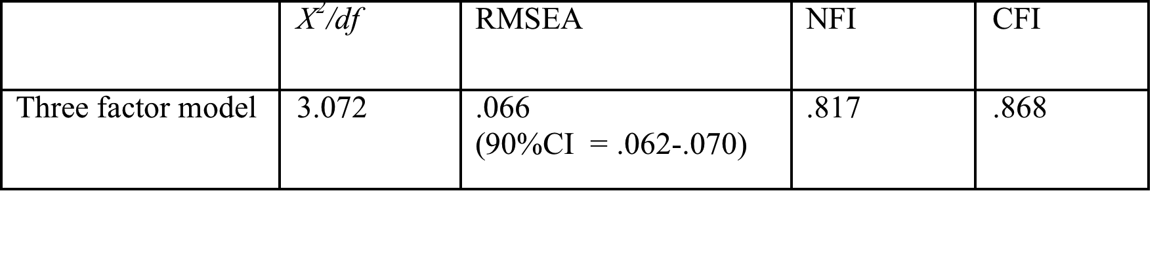
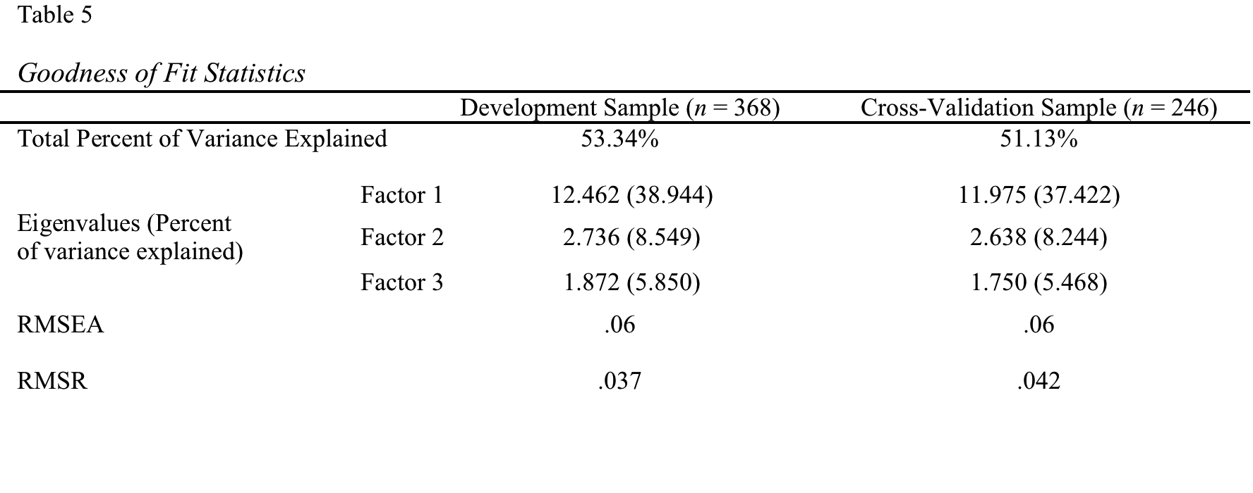
Results: Psychometric Properties
Goodness of fit indices
EFAs (First psychometric examination)
Test-retest reliability (N=107)
R= .93
CFA (Second psychometric examination)
 |  | Development Sample (n = 368) | Cross-Validation Sample (n = 246)
Total Percent of Variance Explained |  | 53.34% | 51.13%
Eigenvalues (Percent of variance explained) | Factor 1 | 12.462 (38.944) | 11.975 (37.422)
 |  | 2.736 (8.549) | 2.638 (8.244)
 | Factor 2
 |  | 1.872 (5.850) | 1.750 (5.468)
 | Factor 3
RMSEA |  | .06 | .06
RMSR |  | .037 | .042
 | Chi-squared/df | RMSEA | NFI | CFI
Three factor model | 3.072 | .066 (90% CI= .062 -. 070) | .817 | .868
Notes:
The measure demonstrated strong test-retest reliability (.93) when re-administered at an interval between 7 to 14 days (n=107). See Table 3 (below) for information concerning goodness of fit statistics and internal consistency.
CFA- Items were restrained to their exploratory factor loadings
As can be seen in the figure below, factor structure remained stable and variables reached acceptable to excellent levels of factor affiliation ranging from .41 to .76. (Comrey & Lee, 1992).
Fit indices for the CFA were as follows: Χ²/df ratio (Bryant & Yarnold, 1995), Root Mean Square Error of Approximation (RMSEA; Steiger, 1990), Normed Fit Index (NFI, Bentler & Bonett, 1980), and Comparative Fit Index (CFI, Bentler, 1990). A good fitting model has a small Χ²/df ratio (closer to zero), a RMSEA of .05 or below (.08 marginal, .10 poor fit; Browne & Cudeck, 1993), and NFI/CFI values over .90. The χ²/df ratio was 3.48, which approached an acceptable fit. The RMSEA values were in the acceptable range at .066 (90% CI =.062-.070). Finally, theCFI (.868) and NFI (.817) mirrored these findings with almost moderate fit values for the original factor structure.

Slide 9
Conclusions
Three factor model supported across independent samples
Mental health consumer
Integration of other social sciences
Ongoing research

Slide 10
Future Directions
Large mental health systems
Modify for usage with practitioners and other stakeholders
Access information at little cost
Inform dissemination strategy

